Slide 1
Hypothesis Testing
Review

Slide 2
Introduction
Definition Hypothesis testing is a formal approach for determining if data from a sample support a claim about a population.
State the null and alternative hypotheses
Calculate the test statistic
Find the critical value (or calculate the P-value)
State the technical conclusion
State the final conclusion

Slide 3
The Process
Claim: More than half the students at a particular university are from out of state
Step 1: State the null and alternative hypotheses
Define the parameter
p = The proportion of all students at the university who are from out of state
State the hypotheses
H₀: p = 0.50 H₁: p > 0.50

Slide 4
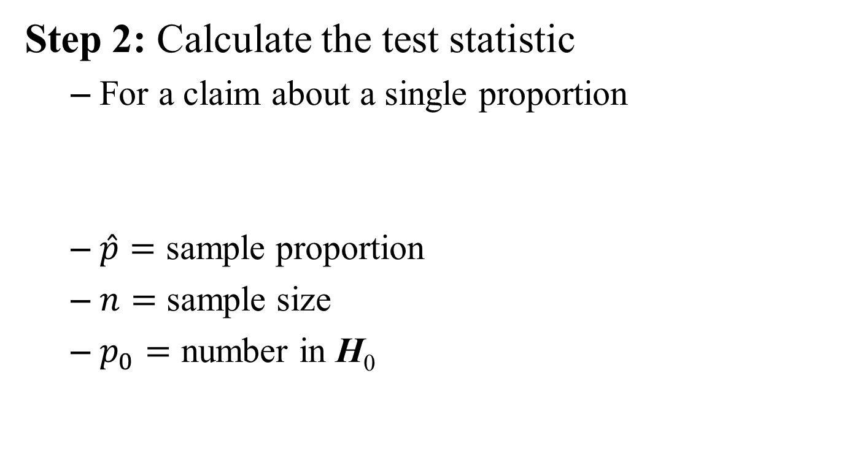
The Process
Step 2: Calculate the test statistic
For a claim about a single proportion
$\hat{p}=$ sample proportion
$n=$ sample size
$p_{0}=$ number in H₀

Slide 5
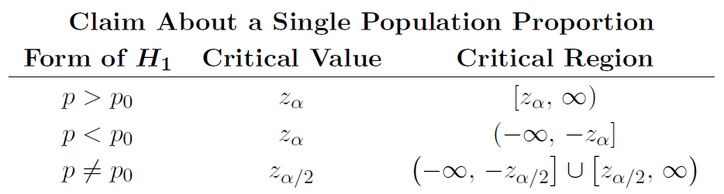
The Process
Step 3: Find the critical value
At the 95% confidence level,

Slide 6
The Process
Step 4: State the technical conclusion
One of two statements:
Reject H₀ or Do not reject H₀
Reject H₀ if the test statistic falls into the critical region and do not reject H₀ otherwise
z = 2.36, critical region: [1.645, ∞)
Reject H₀

Slide 7
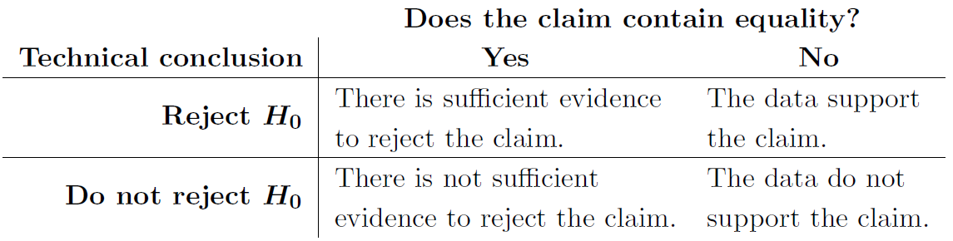
The Process
Step 5: State the final conclusion
The data support the claim

Slide 8
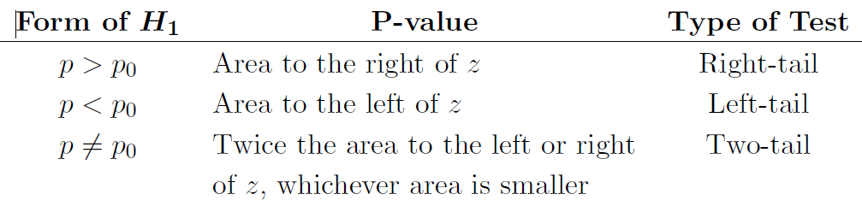
P-value Method
Criteria
Reject H₀ if P-value ≤ α
Do not reject H₀ if P-value > α

Slide 9
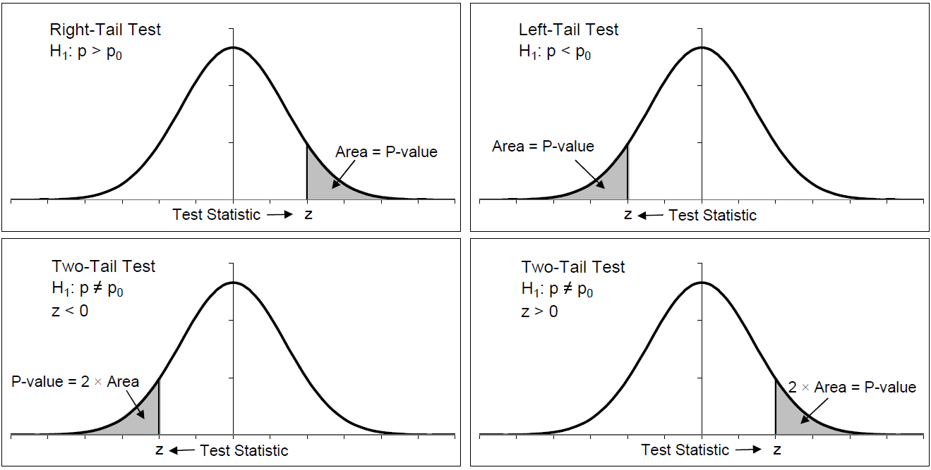
P-value Method

Slide 10
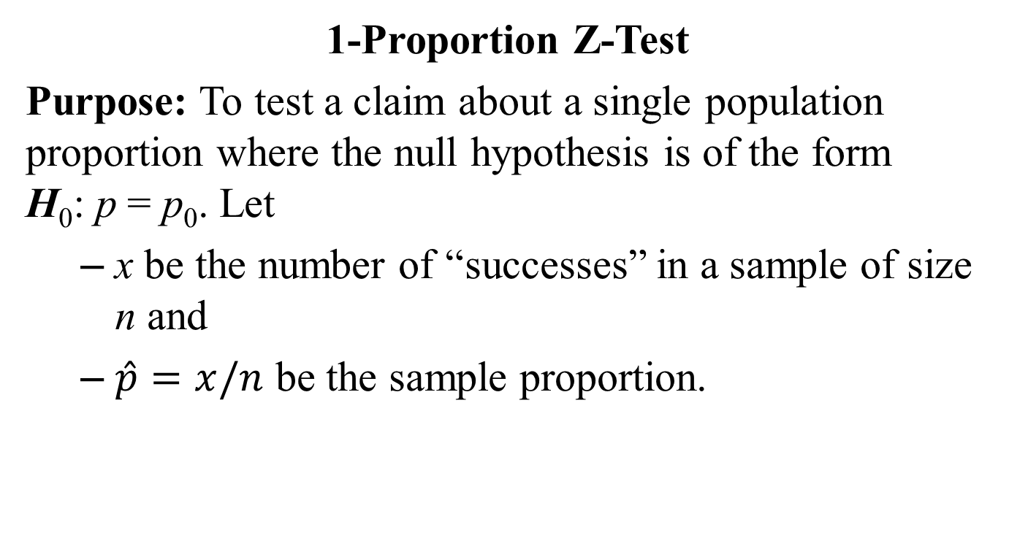
Testing Claims about a Proportion
1-Proportion Z-Test
Purpose: To test a claim about a single population proportion where the null hypothesis is of the form H₀: p = p₀. Let
x be the number of “successes” in a sample of size n and
$\hat{p}=x/n$ be the sample proportion.

Slide 11
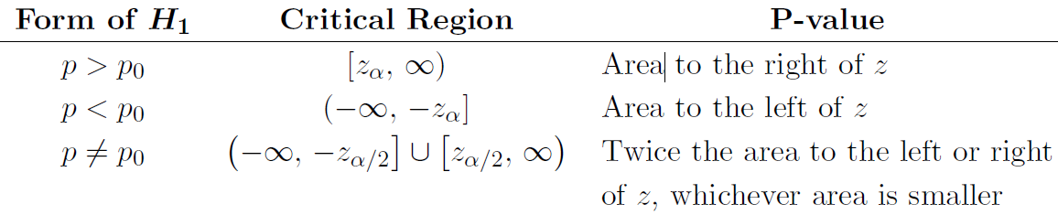
1-Proportion Z-Test
The test statistic is
The critical value is a z-score and the P-value is an area under the standard normal density curve.

Slide 12
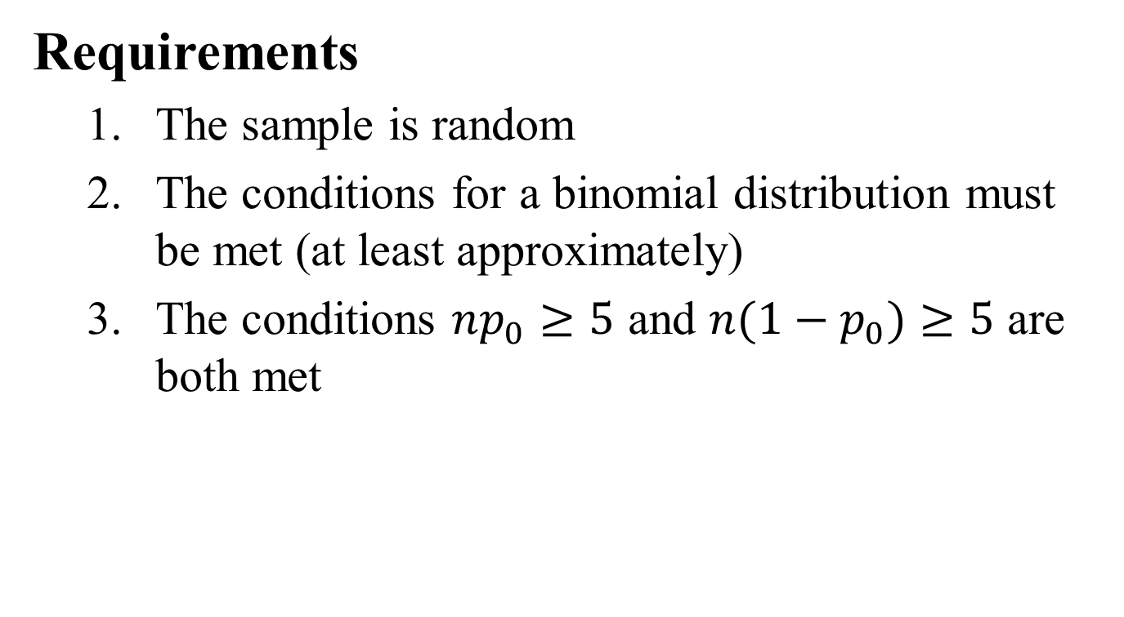
1-Proportion Z-Test
Requirements
The sample is random
The conditions for a binomial distribution must be met (at least approximately)
The conditions $np_{0}≥5$ and $n{(1−p}_{0})≥5$ are both met

Slide 13
Example
A student claims that less than 25% of plain M&M candies are red. A random sample of 195 candies contains 37 red candies. Use this data to test the claim at the 0.05 significance level.
The parameter about which the claim is made is
p = The proportion of all M&M candies that are red

Slide 14
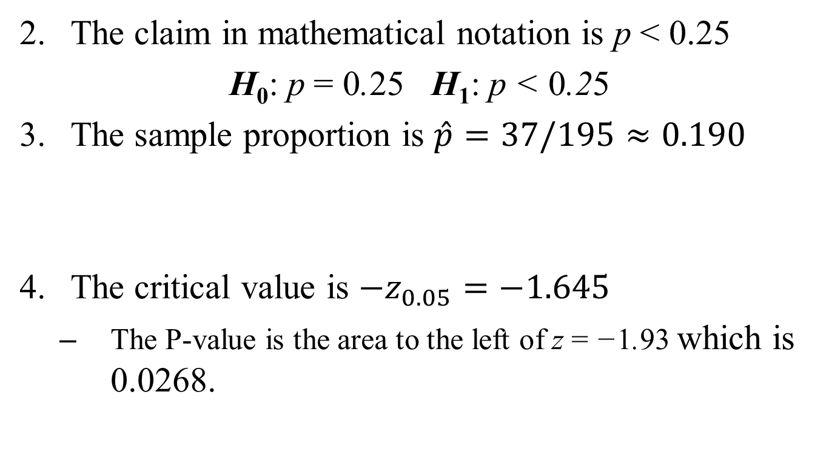
Example
The claim in mathematical notation is p < 0.25
H₀: p = 0.25 H₁: p < 0.25
The sample proportion is $\hat{p}=37/195≈0.190$
The critical value is $−z_{0.05}=−1.645$
The P-value is the area to the left of z = −1.93 which is 0.0268.

Slide 15
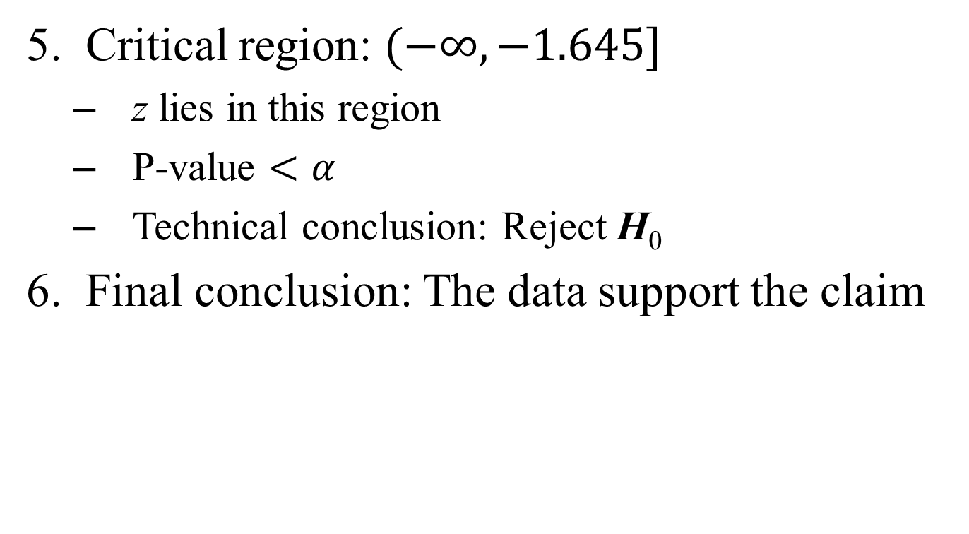
Example
Critical region: $(−∞, −1.645]$
z lies in this region
P-value $<α$
Technical conclusion: Reject H₀
Final conclusion: The data support the claim

Slide 16
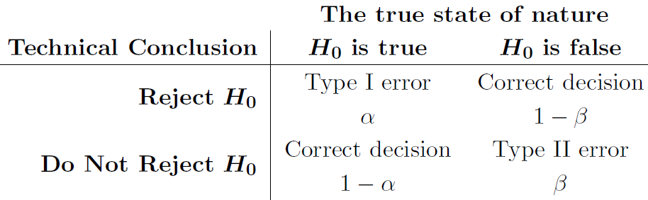
Types of Errors

Slide 17
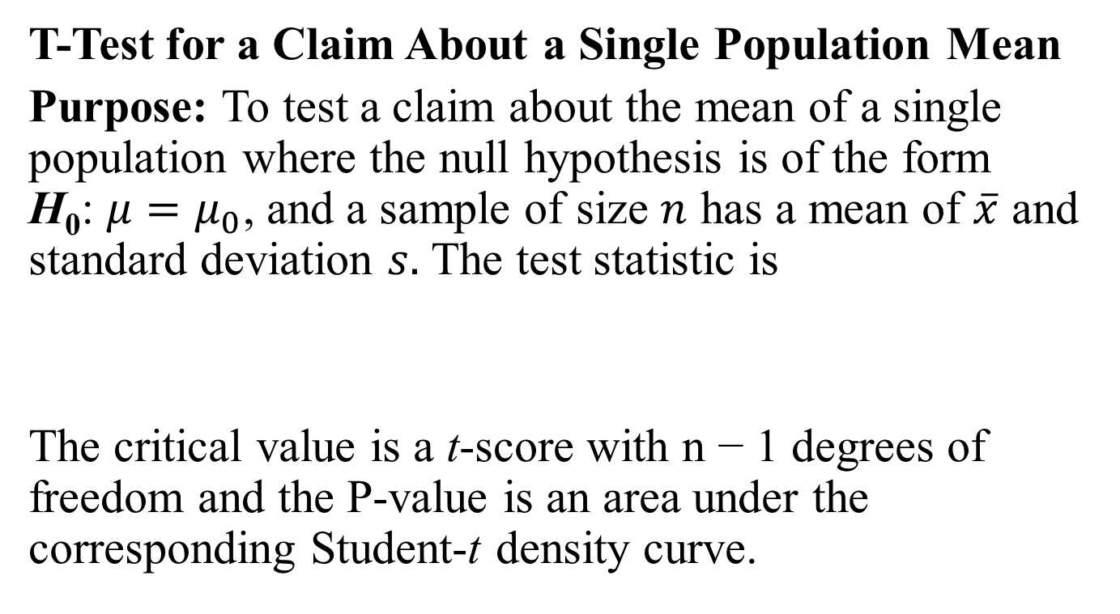
Testing Claims about a Mean
T-Test for a Claim About a Single Population Mean
Purpose: To test a claim about the mean of a single population where the null hypothesis is of the form H₀: $μ=μ_{0}$, and a sample of size $n$ has a mean of $\overline{x}$ and standard deviation $s.$ The test statistic is
The critical value is a t-score with n − 1 degrees of freedom and the P-value is an area under the corresponding Student-t density curve.

Slide 18
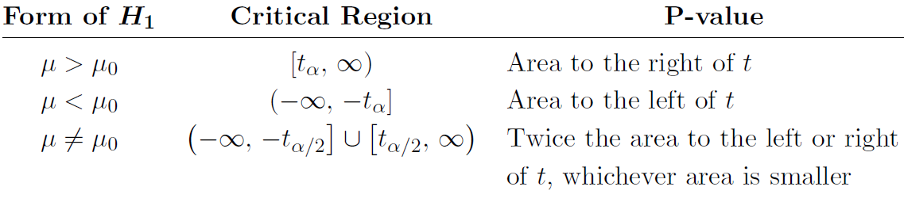
T-Test
Requirements
The sample is random
Either the population is normally distributed or n > 30

Slide 19
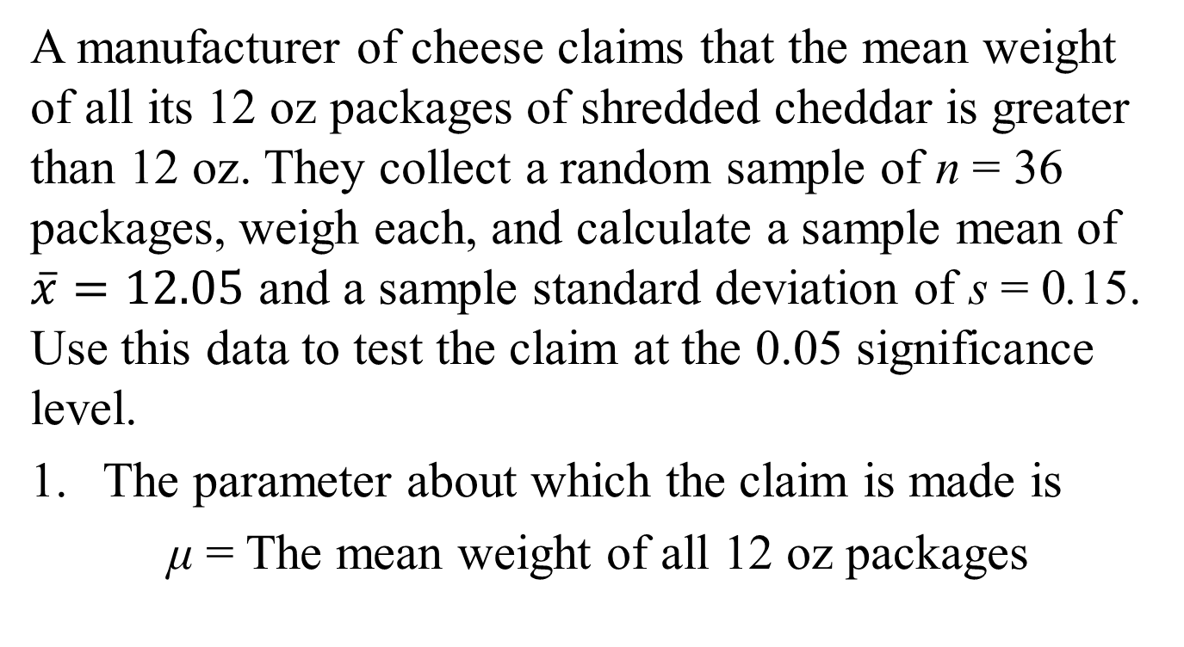
Example
A manufacturer of cheese claims that the mean weight of all its 12 oz packages of shredded cheddar is greater than 12 oz. They collect a random sample of n = 36 packages, weigh each, and calculate a sample mean of $\overline{x}=12.05$ and a sample standard deviation of s = 0.15. Use this data to test the claim at the 0.05 significance level.
The parameter about which the claim is made is
μ = The mean weight of all 12 oz packages

Slide 20
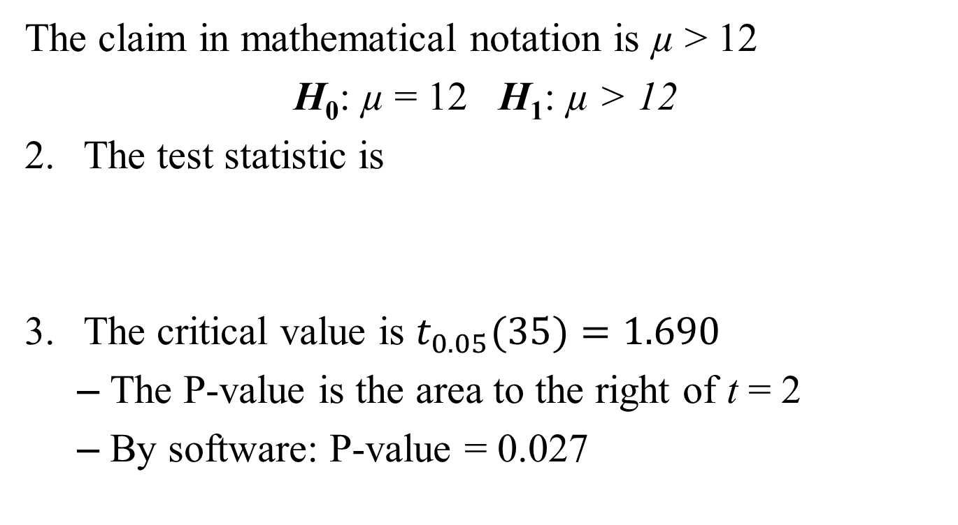
Example
The claim in mathematical notation is µ > 12
H₀: µ = 12 H₁: µ > 12
The test statistic is
The critical value is $t_{0.05}(35)=1.690$
The P-value is the area to the right of t = 2
By software: P-value = 0.027

Slide 21
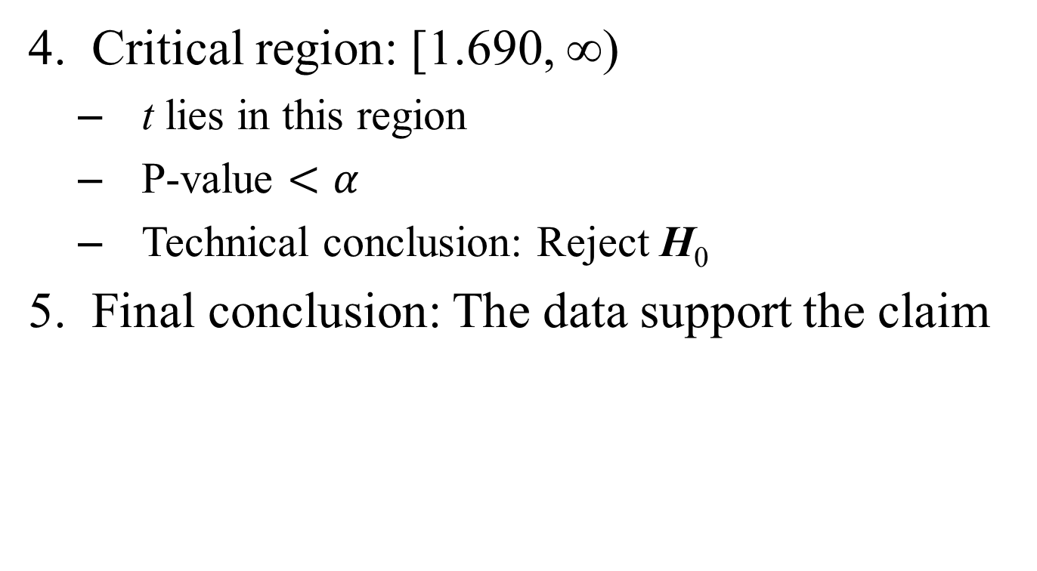
Example
Critical region: [1.690, ∞)
t lies in this region
P-value $<α$
Technical conclusion: Reject H₀
Final conclusion: The data support the claim

